Slide 1
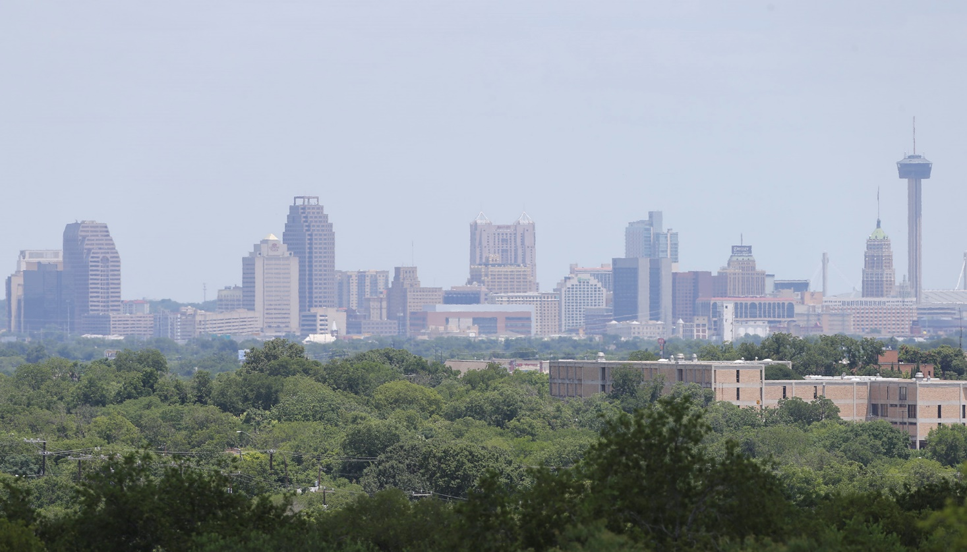

Hi-Res Maps and Forecasts of Air Quality in San Antonio
Team Jellyfish
Rongrong Wei, PhD
Frank DeVilbiss, PhD

Slide 2
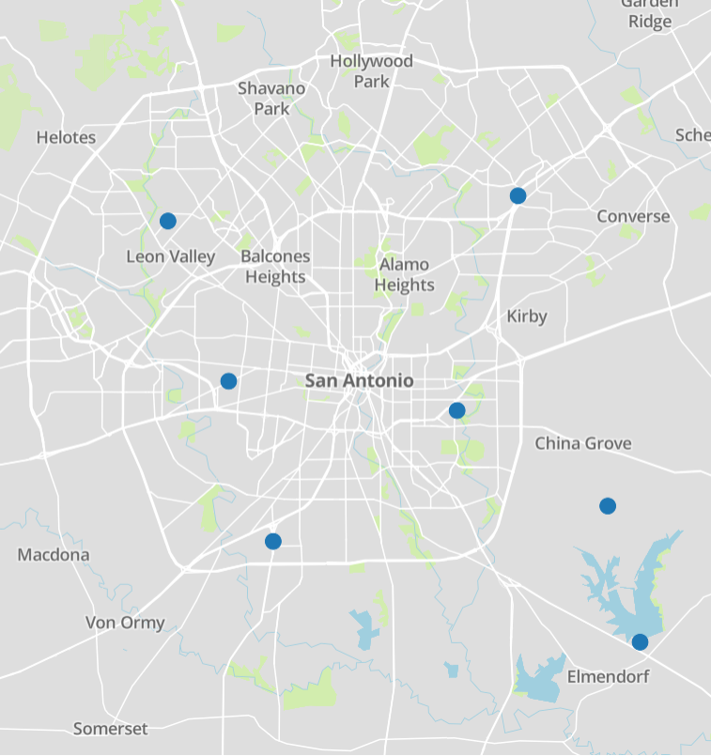


The Problem
PM2.5
General Measure for Air Quality
Impacts Health
22k to 55k Deaths/Year in US
Impacts Climate
Impacts Local Economy
$3.2 to $36.2 Billion!!!
Not enough sensors
465 sq. miles
Only a handful of measurement sites

Slide 3
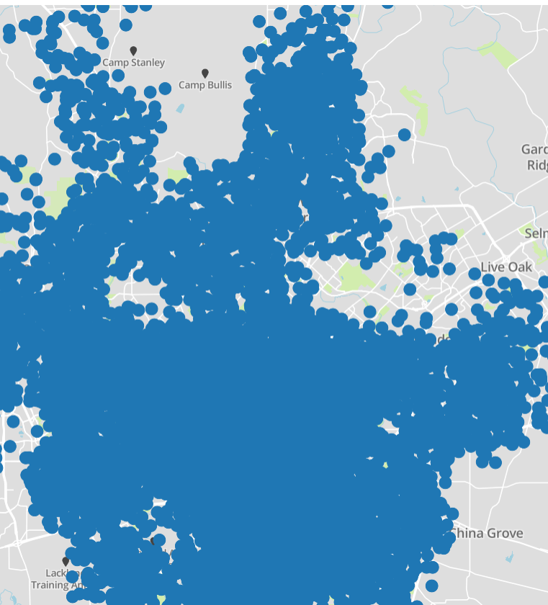
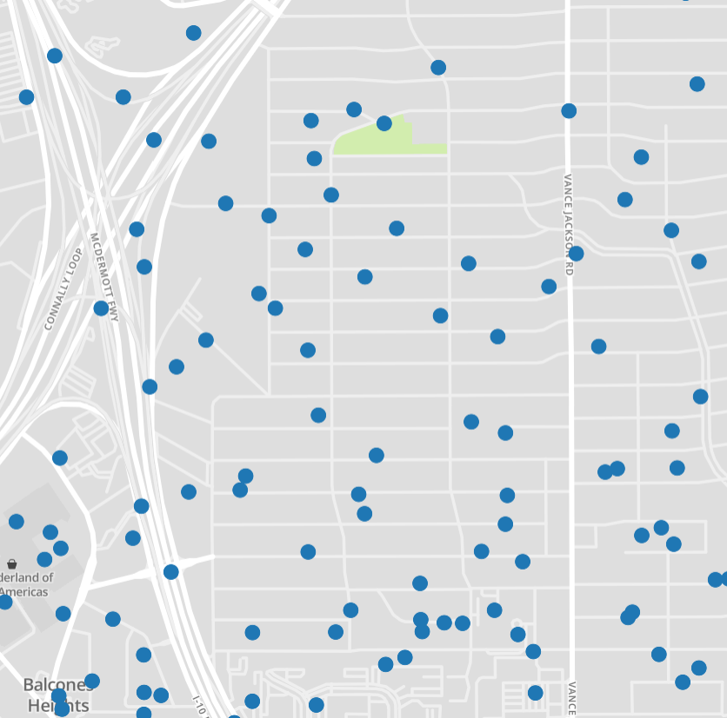
Energy Usage

Slide 4
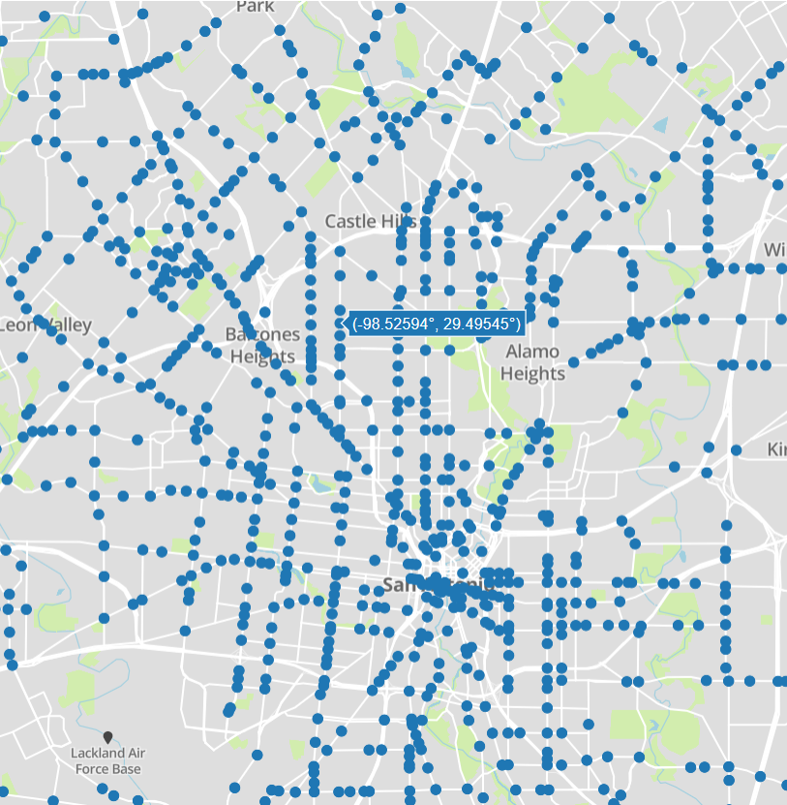
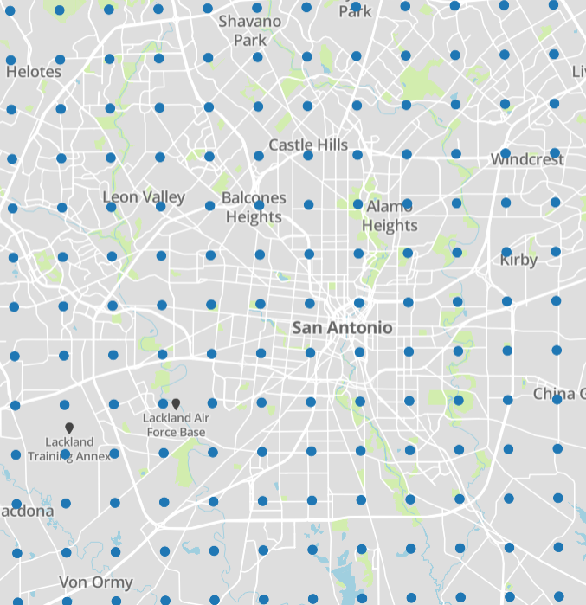


Traffic
Climate Models

Slide 5
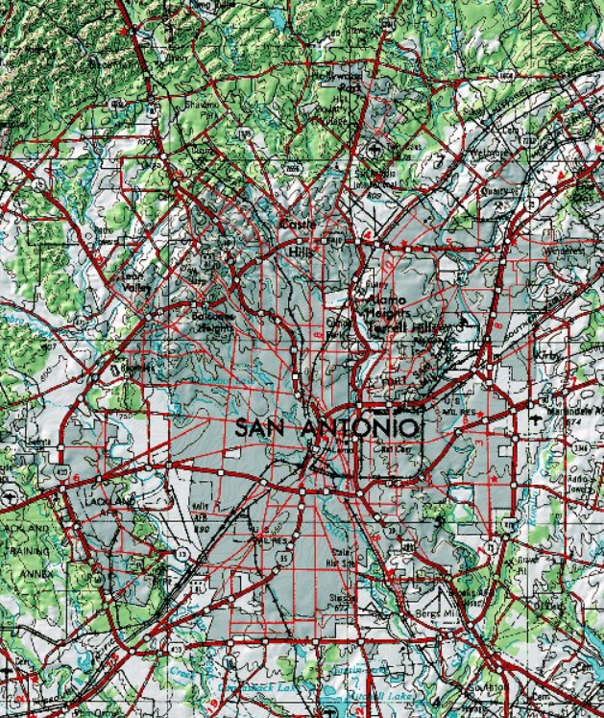
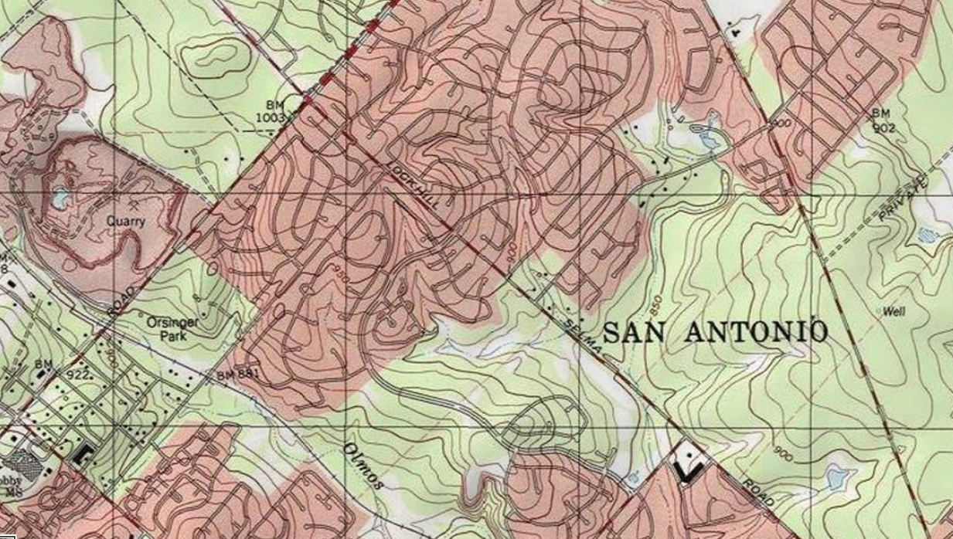

Topographical Data

Slide 6

Predictive Modeling
PM2.5 Prediction
Surface Temperature
Wind Speed
Traffic Speed
Traffic Volume
Road Occupancy
Local Energy Usage
Elevation
Month
Day of the Week
Time of the Day
Machine Learning Algorithm
40,000 Historical Data Points
Built 1,000 candidate models
Best performing model:
Test Set Error (RMSE): < 3.0 µg/m³
Test Set R² Value: 0.62

Slide 7
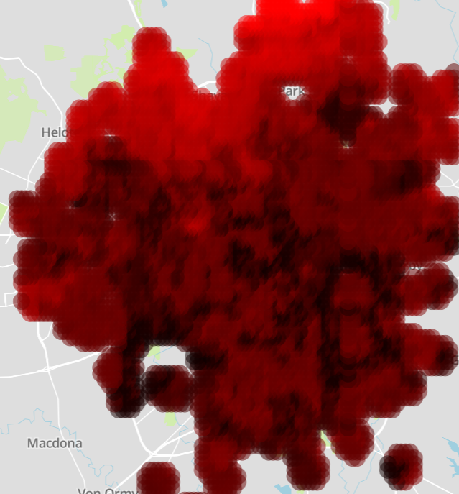

One of the Highest Resolution Depictions of Air Quality in SA Ever Created:
PM2.5 = 20µg/m³
PM2.5 = 35µg/m³
What pollution looks like on a relatively bad day in SA

Slide 8
Prediction of Future Air Quality in SA
PM2.5 Prediction
Surface Temperature
Wind Speed
Traffic Speed
Traffic Volume
Road Occupancy
Local Energy Usage
Elevation
Month
Day of the Week
Time of the Day
Machine Learning Algorithm
"What will pollution look like if traffic increases in this intersection by 20 percent?"
"How will climate change influence air pollution in SA?"
"How will future energy usage change in this neighborhood correlate with pollution levels?"

Slide 9
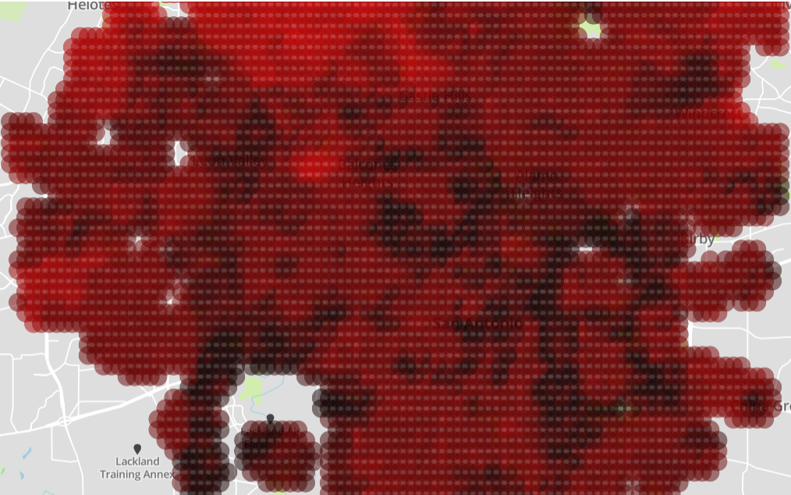
Normal
PM2.5 = 20µg/m³
PM2.5 = 35µg/m³

Slide 10
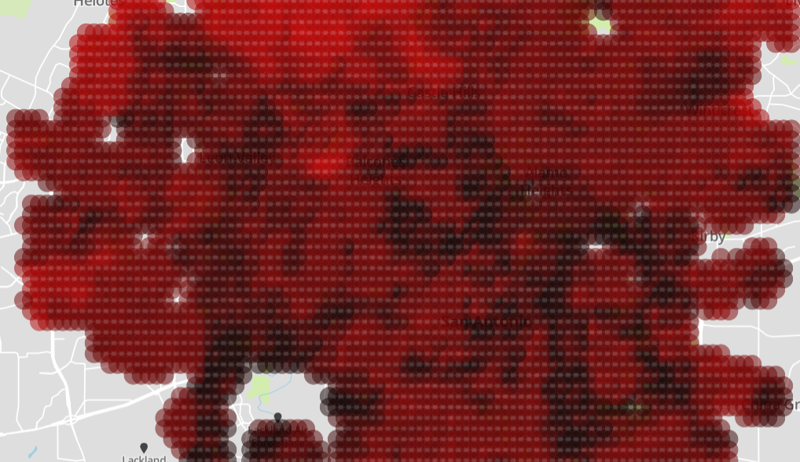
20% More Congestion
PM2.5 = 20µg/m³
PM2.5 = 35µg/m³

Slide 11
Air Quality Improvement Starts With Better Insight
Empower City Leadership
Short term – Weather Forecast
Telecommuting
Incentivizeg Alternate Travel Plans
Carpooling
Bus Traffic
Long Term – 5 Year Predictions
Planning Future Green Space
Infrastructure Development
Zoning
Empower Individuals
Plan activities based on local pollution
Choose where to live
More conscientious about health screening
Proof of Concept for Many More Applications
Predict Ozone Levels
Predict Water Quality

Slide 12
Try it out for yourself:
http://fr4nk.us/air

